Slide 1
Types of data, and input for assessment models
FISH 576, Winter 2025, Week 1

Slide 2
Looking ahead
This week, you will read the assessment reports for widow and yelloweye rockfish.
Next week, you will divide into two stock assessment teams
As a team, you will decide who does what tasks
During this lecture and as you read, consider what you would like to help with

Slide 3
One goal of stock assessment
Assimilate all information to understand the system and provide management advice
Use the data to outline hypotheses to be tested during modeling
Data will inform model structure(s)

Slide 4
General sources of information
Scientific understanding
Fundamentals of population dynamics
Literature
Data
Fishery monitoring and survey data
Fit model to data or use as forcing functions
Similarities with other species
E.g. borrow natural mortality from a similar species
Used to fix or provide information on model parameters or structure
Expert opinion
A historian considers catch to be substantial for many years before historical records were kept
Used to refine assumptions and model structure
Anecdotes
A fisherman notes that after a vessel buyback CPUE increased for the vessels left in the fishery.
Used to develop conceptual model, refine assumptions, and structure assessment model.

Slide 5
Quantitative data sources
Removals
Size and age-composition of removals
Relative or absolute estimate of abundance
Fishery independent or dependent
Size and age-composition from surveys
Other biological information
Maturity, fecundity, weight-length relationship, etc.
Ecosystem data

Slide 6
Main west coast data sources
PacFIN: Pacific fisheries information network, commercial data since 1981
RecFIN: Recreational fisheries information network, recreational data since ~1981 (spans multiple sampling programs)
ASHOP: At-sea hake observer program, data for Pacific hake catcher-processors and motherships. (Shoreside hake fishery is in PacFIN.)
WCGOP: West coast groundfish observer program, observes commercial fisheries since 2002
GEMM: Groundfish Expanded Mortality Multiyear, estimate of dead catch (landings and discards) by sector and species
WCGBTS: West coast groundfish bottom trawl survey, most common current source of fishery-independent data for west coast groundfish

Slide 7
Fishery Dependent Data
Fishery Data Flows
Commercial Landings Data
(WA, OR, CA)
Pacific States
Marine Fisheries Commission
(PacFIN, RecFIN)
Age-length Compositions
Recreational Landings Data
(WA, OR, CA)
Total Fishing Mortality Estimates / Discard Rates
Fishery-dependent index of abundance
Observer Data
(WCGOP, ASHOP, etc.)
Assessments
Fishery Independent Data
Age, Length, Maturity & Life
History Information
Current and historical surveys
(Relative) Biomass Estimates

Slide 8
Landings
History of removals
We usually go back to the start of the fishery
Other assessments may estimate a fished initial condition
Stratified, where appropriate, by area, fishing gear, etc.
Model assumes ages/sizes within a fleet are homogenous
Data sources: PacFIN, RecFIN, ASHOP, historical state reconstructions
Tools: R data manipulation
Notes:
Get class sablefish landings code

Slide 9
Discards
Many ways to account for this, depends on fishery dynamics and available data
Three main options
Add estimates of dead discards to landings.
Include separate discard fleet with a selectivity curve.
Estimate retention curve and fit discard fractions/amounts.
Yelloweye model uses option (1) and widow model option (3)
Data sources: WCGOP, GEMM, RecFIN
Tools: R data manipulation, WCGOP data is pre-processed

Slide 10
Indices of abundance
Fishery-independent
Methods to standardize each survey’s data are established, will run data for your species or receive the index time series
Data Source: WCGBTS, historical surveys, recruitment survey, others
Tools: {indexwc}, {sdmTMB}
Fishery-dependent
Requires more species-specific analysis
Data Source: Rec observer programs, WCGOP, others
Tools: {sdmTMB}, other regression functions/packages

Slide 11
Age and length composition data
Can be useful for estimating:
Recruitment
Growth/size at age
Natural and fishing mortality rates
Truncation/expansion of age structure over time
Fishery and Survey selectivity

Slide 12
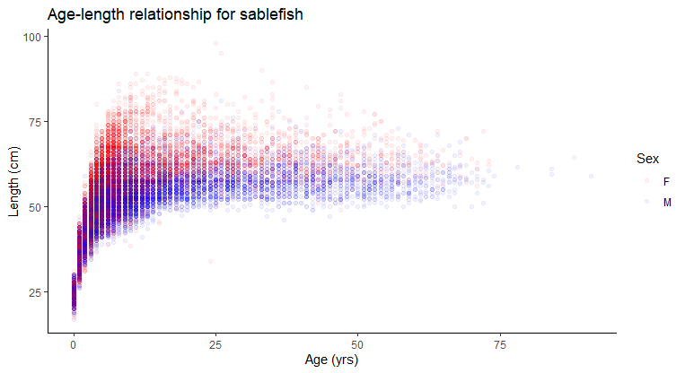
Importance of Age Data
Asymptotic length reached decades before maximum age
Age determination is vital to understanding population structure

Slide 13
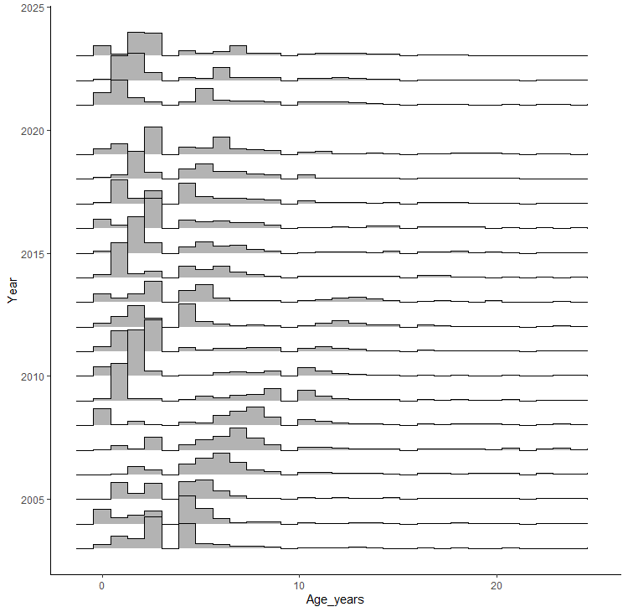
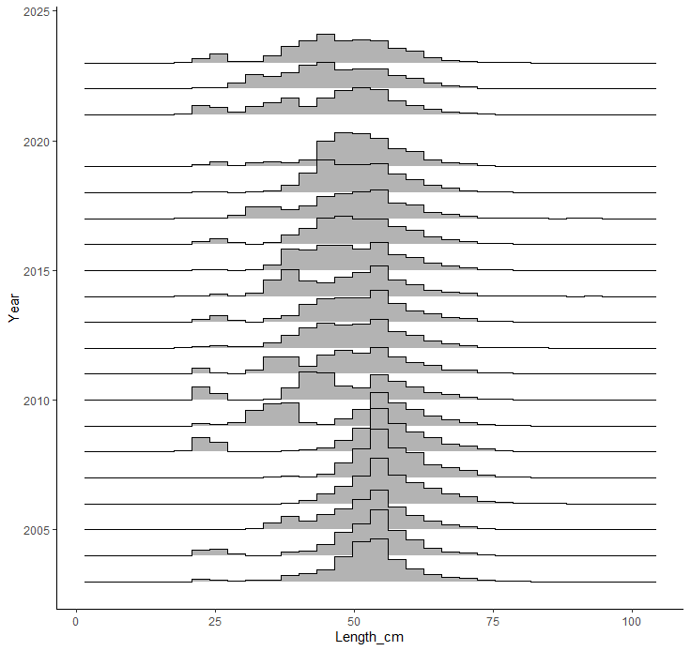
Example: sablefish

Slide 14
Investigating Length and Age Data
N trips, N fish -> Input N for assessment
How will samples from different areas be combined?
Weighted by trip or market category within trip and then state landings
Sexed and unsexed data, changes over time?
Often have sexed age comps
May have unsexed length comps

Slide 15
Age and length data sources
Fishery
Data Sources: PacFIN, RecFIN, ASHOP
Tools: {PacFIN.Utilities}, R data manipulation
Survey
Data Sources: WCGBTS, historical surveys
Tools: {nwfscSurvey}

Slide 16
Other biological data
Maturity at length/age
Fecundity at length/age
Weight at length
Natural mortality and stock-recruit steepness
Either estimated in the model (can be hard) or based on a meta-analysis
Update if new data/priors are available, otherwise retain from previous assessment

Slide 17
Concluding thoughts
~80% of your time will be spent on data issues
Data will arrive late
Keep asking questions until you are satisfied
Do not be satisfied easily
When your model does not fit the data ask more questions about how the data were collected or prepared.
Try to use the data at it is collected (e.g. lengths) rather than derived data products (e.g. lengths converted to ages)
Identify data needs to be collected for future assessments

